Slide 1


Students & Sustainability Magna Charta Observatory Conference, 16th October 2019
Quinn Runkle – Director of Education, SOS-UK
Notes:
Recent research shows that 91% of students say they are concerned about climate change, more than ever before. What can universities do to respond to the demand from students to see action on sustainability?
This session will share examples of student-led initiatives, supported by UK universities and students' unions. It will unpick the key success factors for supporting student learning and leadership for sustainability and share learning through case studies, stories, and evidence.
Participants will discuss the challenges and opportunities facing their own institutions when engaging students in sustainability, and work together to find meaningful solutions.
Students Organising for Sustainability believe higher education has a responsibility to ensure their graduates have the knowledge, skills and attributes to create a more just and sustainable world for all. This session will explore how we can meet this challenge and respond to the mounting demand from students to see sustainability embedded in their university experiences.

Slide 2
Aims for today
Share with you the interest and demand from students to include sustainability in their learning;
Explain what this demand actually looks like;
Demonstrate how sustainability can embedded across student learning;
And discuss why this matters for students, our universities, and wider society.

Slide 3
What do students want?
85%
Agree or strongly agree that “sustainable development is something which universities and colleges should actively incorporate and promote”
70%
Agree or strongly agree that “sustainable development is something which university and college courses should actively incorporate and promote”
60%
Agree or strongly agree that “sustainable development is something which I would like to learn more about”
c70,000 student respondents over the last 10 years
https://sustainability.nus.org.uk/our-research/our-research/skills-and-sustainable-development
Notes:
We have 10 years of data demonstrating student demand
Robust, representative data set (not self-selecting sustainability students!)

Slide 4
Students around the world express their concern about climate change
UK
International
Governments from across the world should do whatever it takes to address climate change
I am concerned about the effects of climate change
I would vote for a Government that increased action to tackle climate change
Climate change will negatively affect me and my lifestyle
Q. How concerned, if at all, are you about climate change? [Responses shown for very or fairly concerned]
* Statistically significant change over the previous quarter (at the 95% confidence level)
Base : In brackets Balance: No response or not concerned

Slide 5
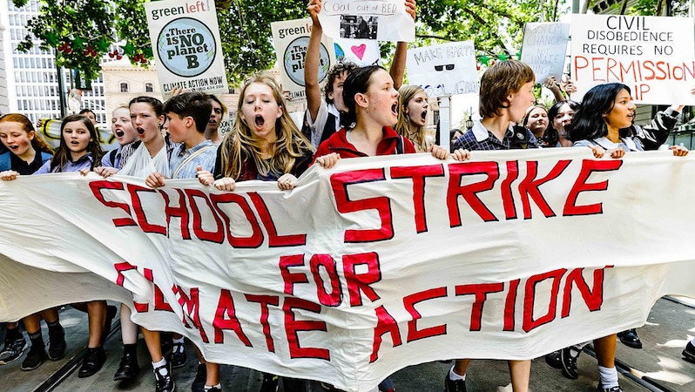
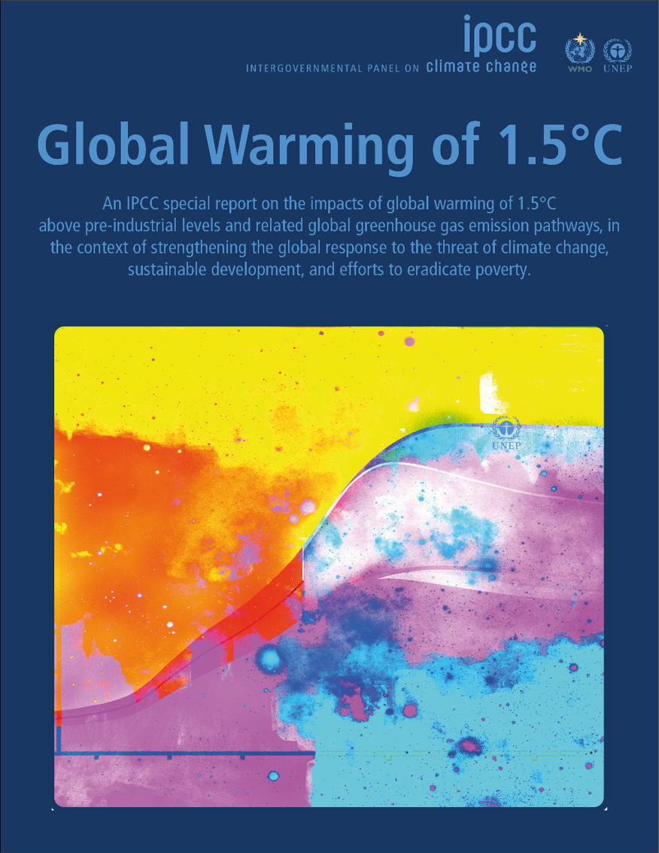
Urgency of the climate crisis

Slide 6
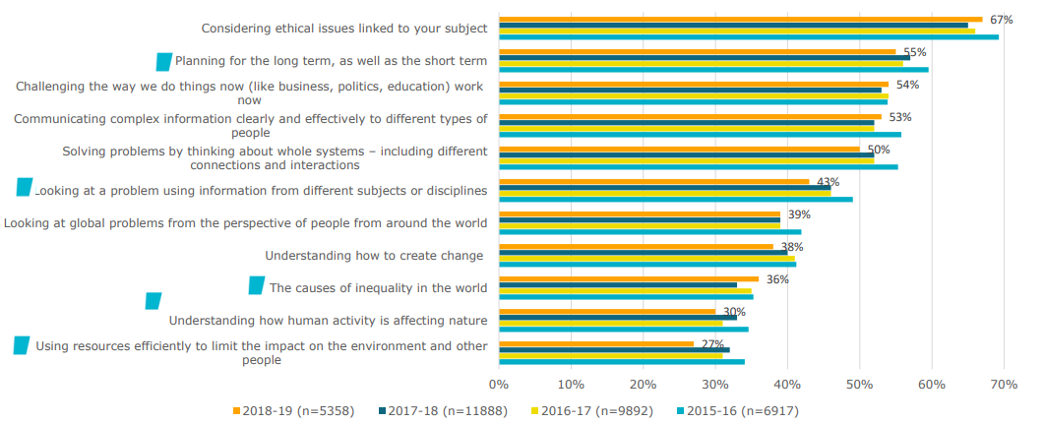
To what extent are students experiencing teaching and learning on sustainability skills and knowledge in higher education?

Slide 7
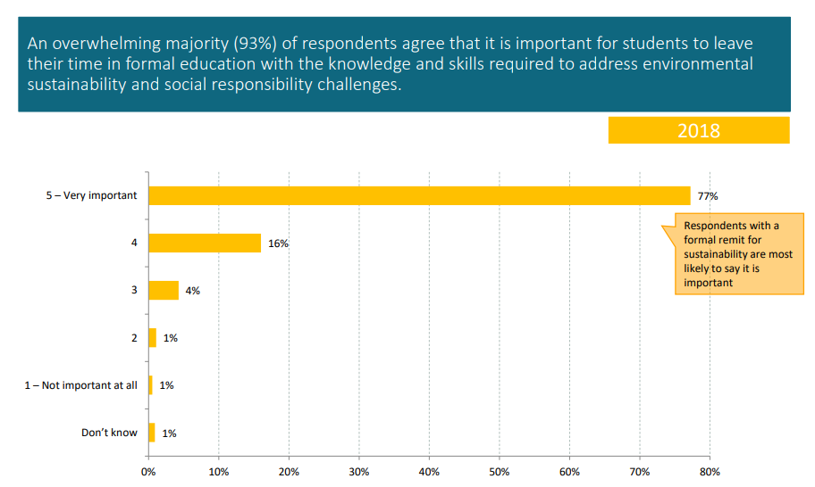
What are staff saying?
Q. In your opinion, how important is it that students leave their time in formal education with the knowledge and skills required to address environmental sustainability and social responsibility challenges?
Sustainability in Education survey, 2018. Research by NUS, EAUC, UCU AoC and CDN. 566 staff from universities, colleges and students’ unions. 139 had formal remit for sustainability, 234 do so on an informal basis and 193 have no remit or responsibility for sustainability

Slide 8
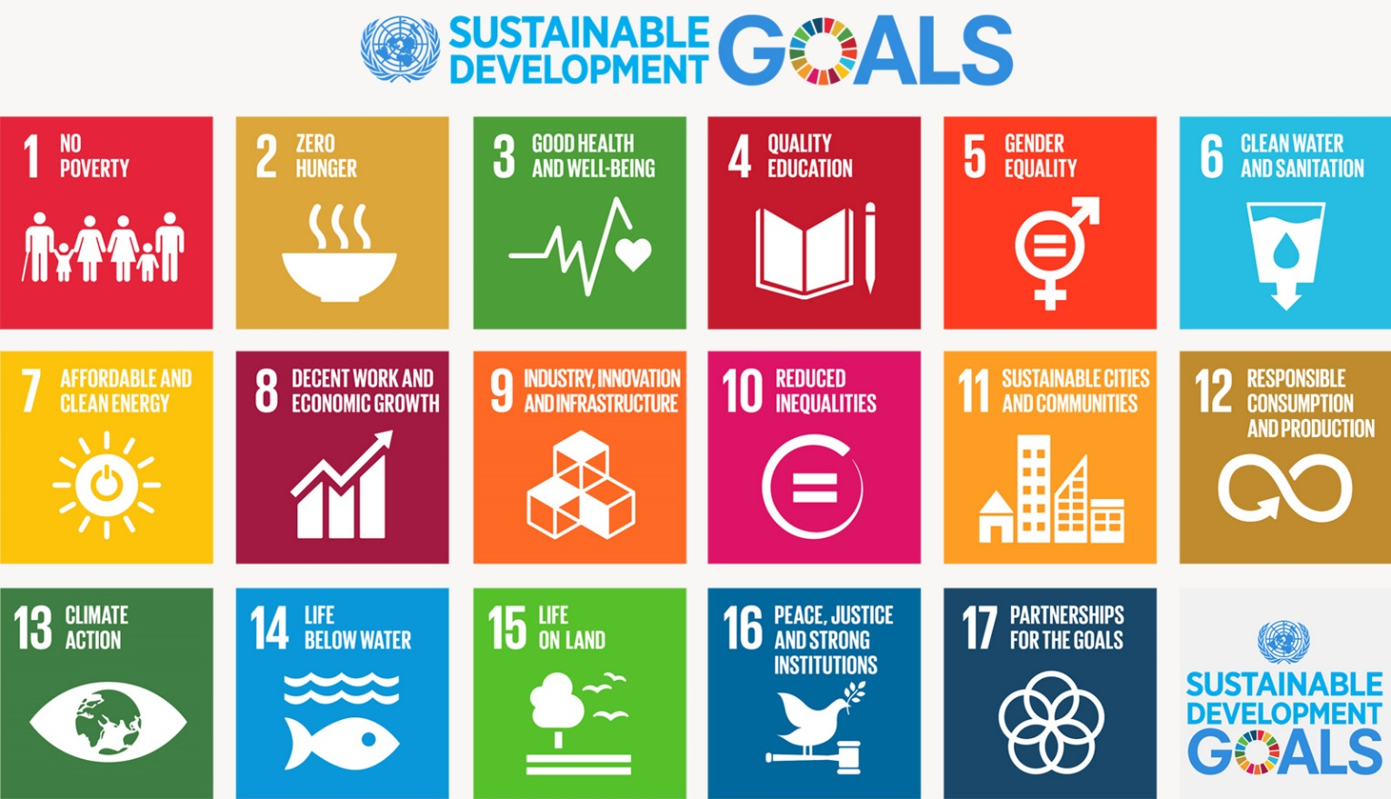
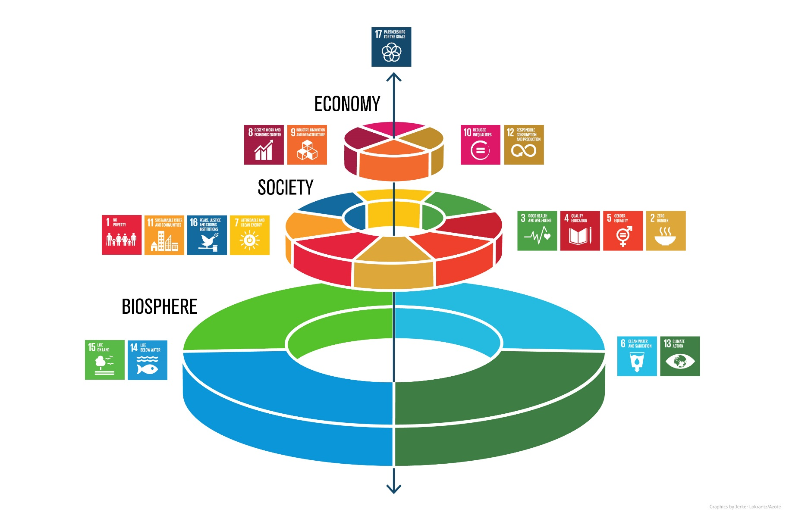
When we’re talking about sustainability, what do we mean…?
Notes:
The SDGs to do with the biosphere are core to any of the others’ existence, the society-focused SDGs exist within the biosphere, and the economic SDGs within society.
The partnerships SDG weaves throughout all of them.
The SDGs aren’t perfect and we can engage critically with them – e.g. 8 talks about economic growth and very much reinforces a capitalist neoliberal paradigm; e.g. there are things missing: why isn’t there an SDG for human rights?
This is the nature of international agreements but they still form a useful tool for understanding the breadth of sustainability and a framework for pushing our institutions, unions, civil society to meaningfully engage

Slide 9
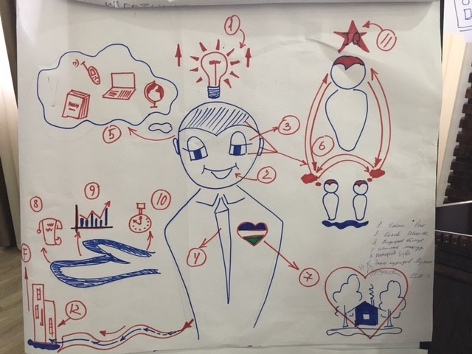
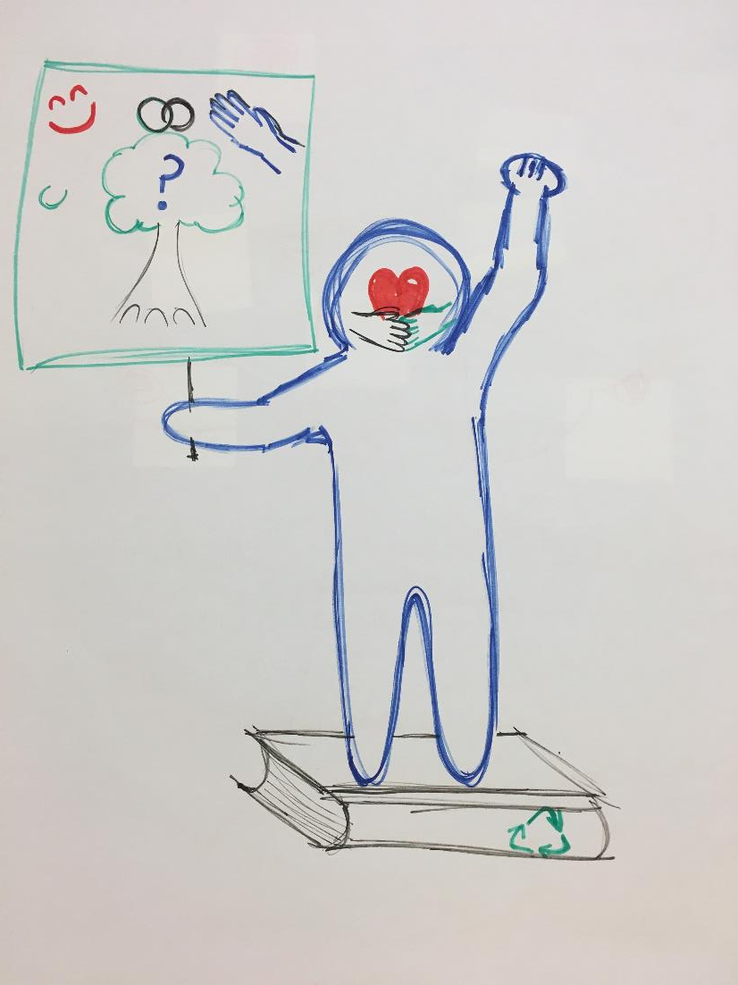
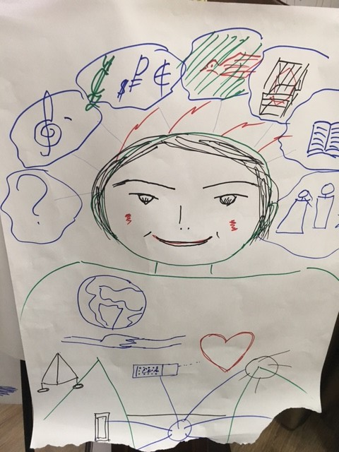
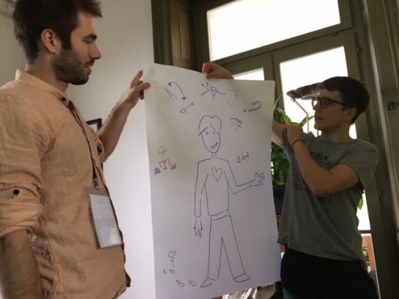
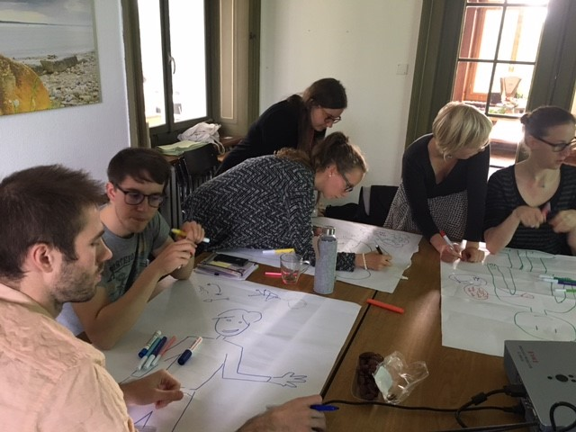
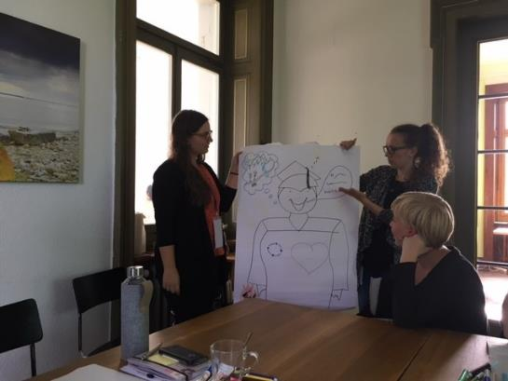
What sort of knowledge, skills, attributes, and values do our graduates need?

Slide 10
Education for sustainable development vs. education about sustainable development
Knowledge
Skills
Attributes
Education for sustainable development is the process of equipping students with the knowledge and understanding, skills and attributes needed to work and live in a way that safeguards environmental, social and economic wellbeing, both in the present and for future generations.
Higher Education Academy & Quality Assurance Agency guidance on ESD (2014)
“Education for Sustainable Development helps the citizens of the world to learn their way to a more sustainable future.”
UN Decade of ESD 2005-2014
Notes:
This means we have adopted this definition of Education for Sustainable Development.
So we don’t see education as simply knowledge acquisition. It’s about ensuring our graduates have the skills, attributes, and values to do something with tthat knowledge in their personal and professional lives.
In its simplest sense: we’re talking about education of the head, hands, and heart

Slide 11
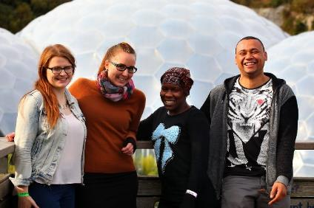
Embedding sustainability through all parts of the student learning experience
Formal Curriculum
Informal Curriculum
Subliminal Curriculum
Notes:
Formal curriculum: sustainability embedded throughout student learning
Informal curriculum: a diverse range of opportunities made available to them
Subliminal curriculum: embedded throughout the practices of an institution (e.g. divestment, gender neutral toilets, etc.) – this makes your estates teams part of educati

Slide 12

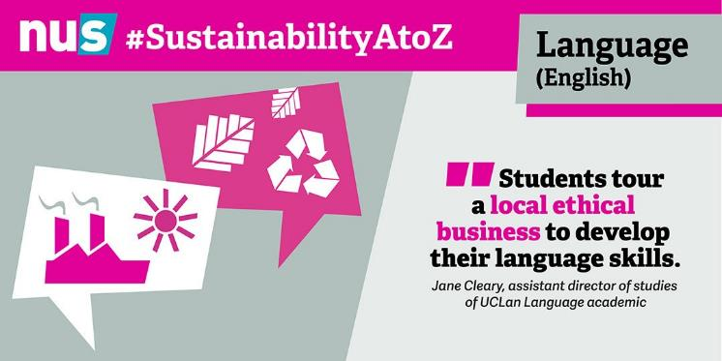
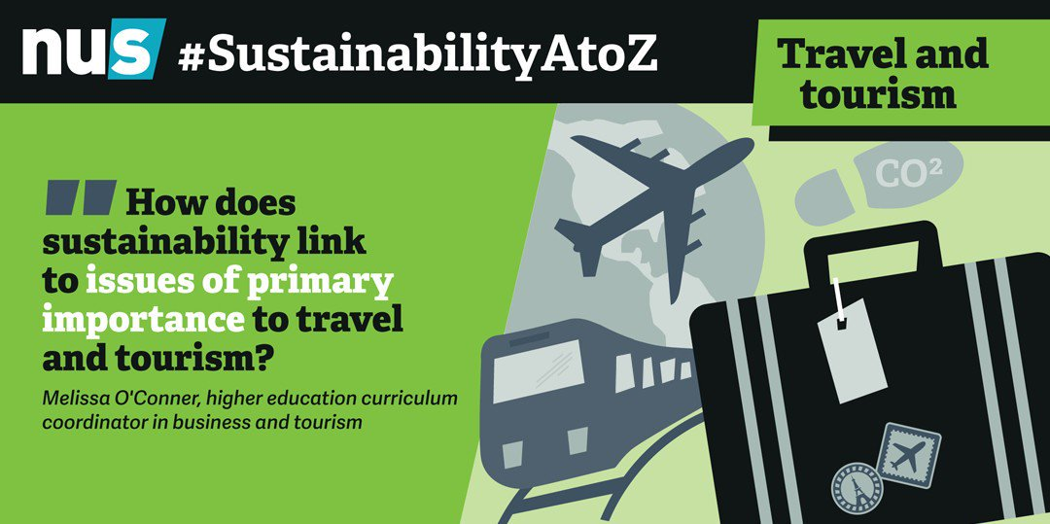

Making sustainability relevant to the discipline and meaningful for students
#SustainabilityAtoZ
Notes:
Link to report: https://sustainability.nus.org.uk/resources/from-art-to-zoo-management-embedding-sustainability-in-uk-higher-and-further-education
We often hear from students and academics alike that it’s “too hard” to embed sustainability within their particular discipline or that it won’t be relevant for themselves or their students. We wanted to dispel that myth because we’d been hearing of examples of good practice from across the UK in the most unexpected courses!
Working with a student placement, we identified examples of good practice in embedding sustainability within the curriculum from Art through to Zoo Management. I’ve got a couple of examples to share with you here and will gladly share the link with anyone who is interested in reading further! It’s easy to find online, too, by searching #SustainabilityAtoZ

Slide 13


What does sustainability look like at your university?
How are students enabled to learn sustainability knowledge and skills? (Through the formal, informal, and subliminal curriculum.)
How might students be supported to further engage? What further changes could be made?
How can universities lead the way to creating a more just and sustainable future?

Slide 14
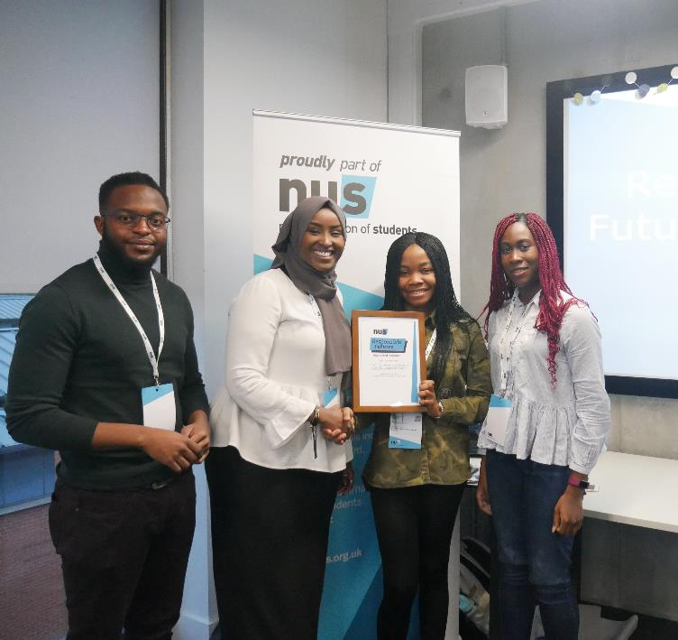

Changing our institutions: Responsible Futures
A whole-institution approach to embedding sustainability throughout student learning
An accreditation mark, audited by students
A good practice framework and supported change programme
A partnership approach between the students’ union and the university
Notes:
https://sustainability.nus.org.uk/responsible-futures

Slide 15

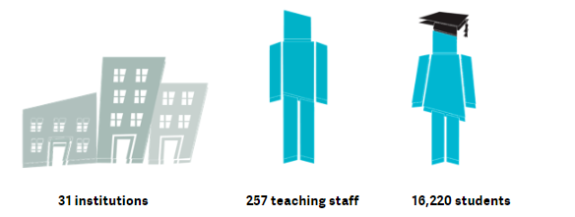
Working collaboratively with staff:
Global Goals Teach-In #SDGTeachIn
An annual international campaign for academics to pledge to include the Global Goals in their teaching, learning, and assessment.
Save the date: 17-21 Feb 2020
Notes:
https://sustainability.unioncloud.org/responsible-futures/esd-teach-in

Slide 16
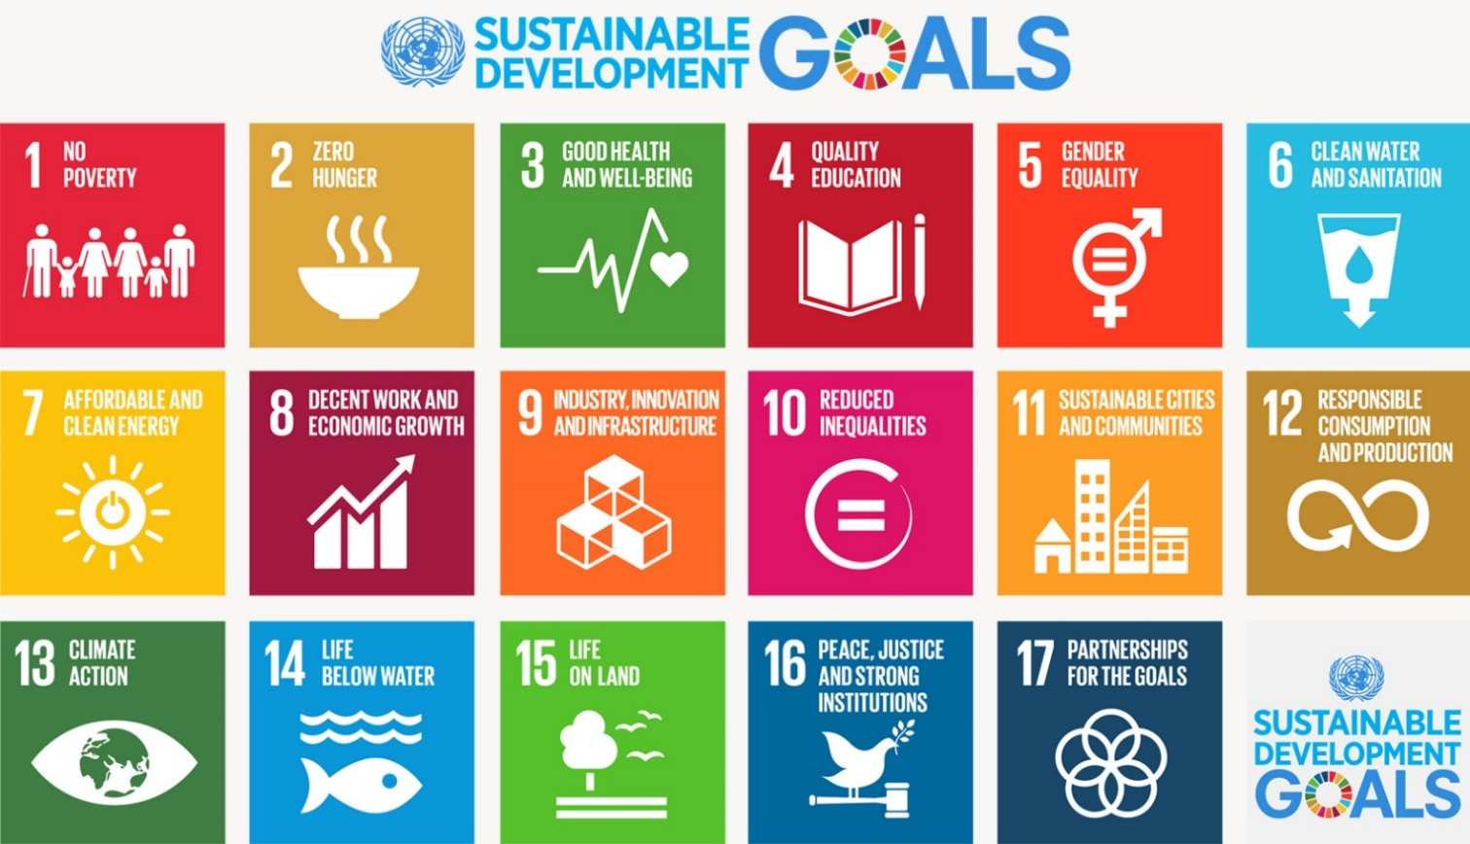
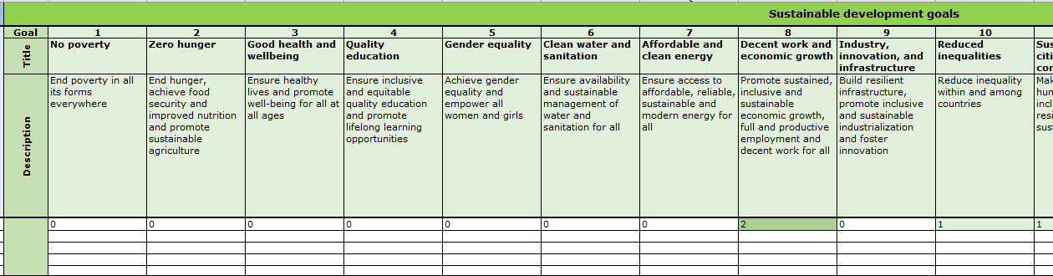
Reforming the curriculum
Measuring the SDGs and ESD pedagogies across all modules

Slide 17
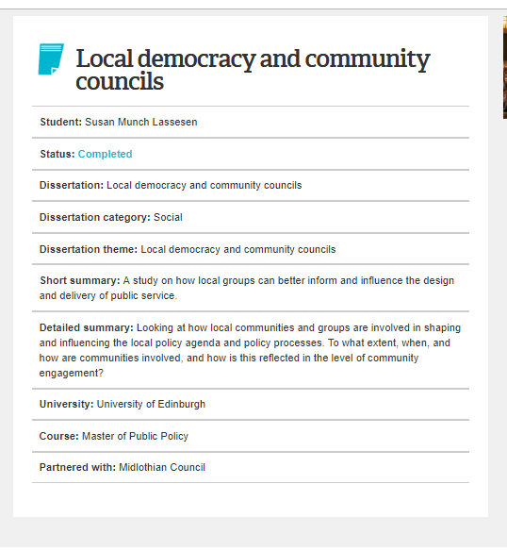
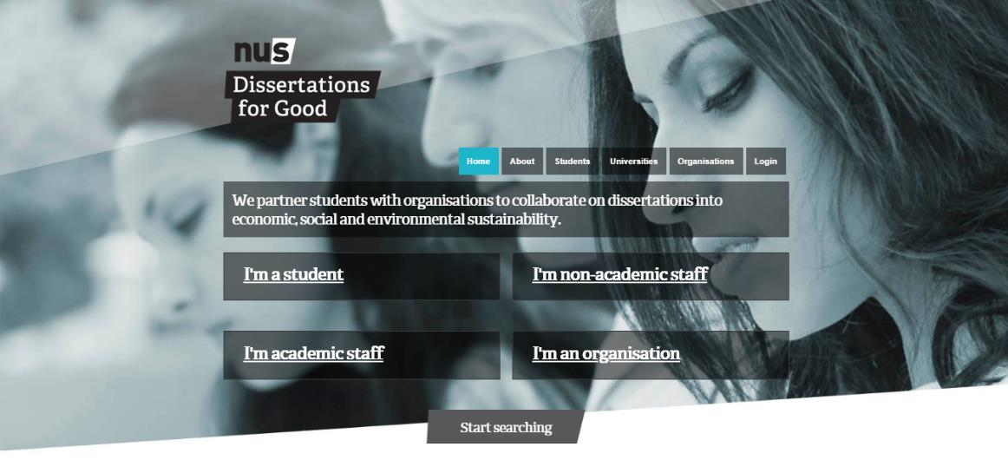
Changing the experience for individual students: Dissertations for Good
“Dissertations for Good has given real meaning to my University studies.”

Slide 18
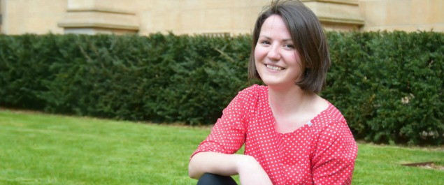
Meet Adela Simonova:
“It started with free icecream…”
Student Switch Off Ambassador in halls
Recycling volunteer at Freshers’ Fair
Green Curriculum team lead
Founded the first-ever student-led SU sustainability committee and elected ‘Sustainability Chair’ for Bristol SU
Bristol SU sustainability ambassador
Bristol Big Give student staff member
Co-ran ‘A Student’s Guide to Sustainability’ event, showcasing student-led research
Adela, from Czech Republic, studied LLB Law at the University of Bristol from 2014-2017, now studying LLM Environment and Climate Change Law at the University of Edinburgh.

Slide 19
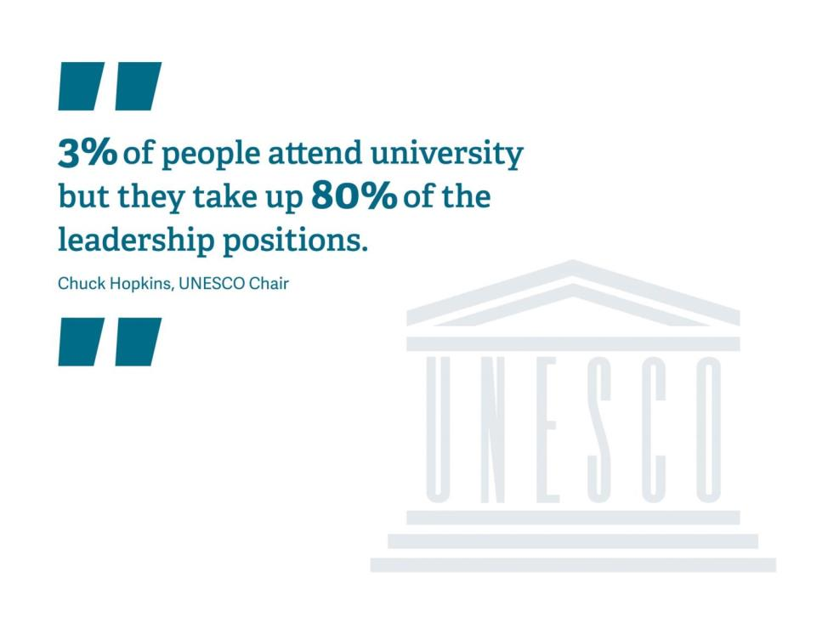

Slide 21
Thank you!
To keep in touch:
www.sos-uk.org
@sosuk_charity
Quinn.Runkle@sos-uk.org
@quinn_runkle

